Slide 1

Chapter 8
Inheritance

Slide 2
Chapter Scope
Deriving classes
Method overriding
Class hierarchies
Abstract classes
Visibility and inheritance

Slide 3
Inheritance
Inheritance allows a software developer to derive a new class from an existing one
The existing class is called the parent class, or superclass, or base class
The derived class is called the child class or subclass
As the name implies, the child inherits characteristics of the parent
That is, the child class inherits the methods and data defined by the parent class

Slide 4
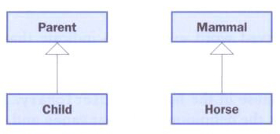
Inheritances
Inheritance relationships are shown in a UML class diagram using a solid arrow with an unfilled triangular arrowhead pointing to the parent class
Proper inheritance creates an is-a relationship, meaning the child is a more specific version of the parent

Slide 5
Inheritance
A programmer can tailor a derived class as needed by adding new variables or methods, or by modifying the inherited ones
Software reuse is a fundamental benefit of inheritance
By using existing software components to create new ones, we capitalize on all the effort that went into the design, implementation, and testing of the existing software

Slide 6
Deriving Subclasses
Java uses the reserved word extends to establish an inheritance relationship
class Car extends Vehicle
{
// class contents
}

Slide 7
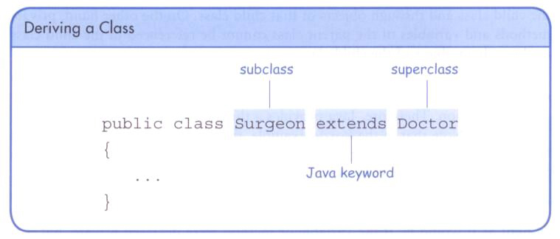
Deriving Classes

Slide 8
//********************************************************************
// Words.java Java Foundations
//
// Demonstrates the use of an inherited method.
//********************************************************************
public class Words
{
//-----------------------------------------------------------------
// Instantiates a derived class and invokes its inherited and
// local methods.
//-----------------------------------------------------------------
public static void main(String[] args)
{
Dictionary webster = new Dictionary();
System.out.println("Number of pages: " + webster.getPages());
System.out.println("Number of definitions: " +
webster.getDefinitions());
System.out.println("Definitions per page: " +
webster.computeRatio());
}
}

Slide 9
//********************************************************************
// Book.java Java Foundations
//
// Represents a book. Used as the parent of a derived class to
// demonstrate inheritance.
//********************************************************************
public class Book
{
protected int pages = 1500;
//----------------------------------------------------------------
// Pages mutator.
//----------------------------------------------------------------
public void setPages(int numPages)
{
pages = numPages;
}
//----------------------------------------------------------------
// Pages accessor.
//----------------------------------------------------------------
public int getPages()
{
return pages;
}
}

Slide 10
//********************************************************************
// Dictionary.java Java Foundations
//
// Represents a dictionary, which is a book. Used to demonstrate
// inheritance.
//********************************************************************
public class Dictionary extends Book
{
private int definitions = 52500;
//-----------------------------------------------------------------
// Prints a message using both local and inherited values.
//-----------------------------------------------------------------
public double computeRatio()
{
return definitions/pages;
}
//----------------------------------------------------------------
// Definitions mutator.
//----------------------------------------------------------------
public void setDefinitions(int numDefinitions)
{
definitions = numDefinitions;
}

Slide 11
//----------------------------------------------------------------
// Definitions accessor.
//----------------------------------------------------------------
public int getDefinitions()
{
return definitions;
}
}

Slide 12
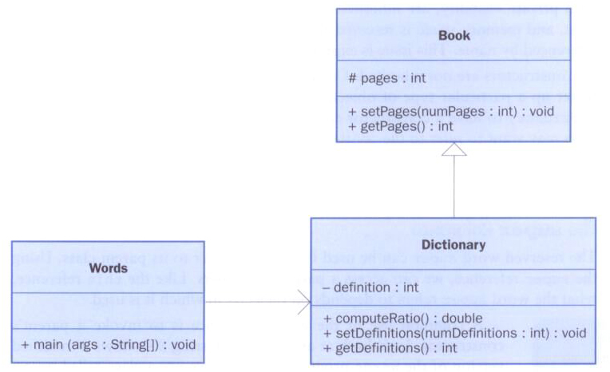
Inheritance

Slide 13
The protected Modifier
Visibility modifiers affect the way that class members can be used in a child class
Variables and methods declared with private visibility cannot be referenced by name in a child
They can be referenced in the child class if they are declared with public visibility – but public variables violate the principle of encapsulation
There is a third visibility modifier that helps in inheritance situations: protected

Slide 14
The protected Modifier
The protected modifier allows a child class to reference a variable or method directly in the child class
It provides more encapsulation than public visibility, but is not as tightly encapsulated as private visibility
A protected variable is visible to any class in the same package as the parent class
The details of all Java modifiers are discussed in Appendix E
Protected variables and methods can be shown with a # symbol preceding them in UML diagrams

Slide 15
The super Reference
Constructors are not inherited, even though they have public visibility
Yet we often want to use the parent's constructor to set up the “parent's part” of the object
The super reference can be used to refer to the parent class, and often is used to invoke the parent's constructor

Slide 16
//********************************************************************
// Words2.java Java Foundations
//
// Demonstrates the use of the super reference.
//********************************************************************
public class Words2
{
//-----------------------------------------------------------------
// Instantiates a derived class and invokes its inherited and
// local methods.
//-----------------------------------------------------------------
public static void main(String[] args)
{
Dictionary2 webster = new Dictionary2(1500, 52500);
System.out.println("Number of pages: " + webster.getPages());
System.out.println("Number of definitions: " +
webster.getDefinitions());
System.out.println("Definitions per page: " +
webster.computeRatio());
}
}

Slide 17
//********************************************************************
// Book2.java Java Foundations
//
// Represents a book. Used as the parent of a derived class to
// demonstrate inheritance and the use of the super reference.
//********************************************************************
public class Book2
{
protected int pages;
//----------------------------------------------------------------
// Constructor: Sets up the book with the specified number of
// pages.
//----------------------------------------------------------------
public Book2(int numPages)
{
pages = numPages;
}
//----------------------------------------------------------------
// Pages mutator.
//----------------------------------------------------------------
public void setPages(int numPages)
{
pages = numPages;
}

Slide 18
//----------------------------------------------------------------
// Pages accessor.
//----------------------------------------------------------------
public int getPages()
{
return pages;
}
}

Slide 19
//********************************************************************
// Dictionary2.java Java Foundations
//
// Represents a dictionary, which is a book. Used to demonstrate
// the use of the super reference.
//********************************************************************
public class Dictionary2 extends Book2
{
private int definitions;
//-----------------------------------------------------------------
// Constructor: Sets up the dictionary with the specified number
// of pages and definitions.
//-----------------------------------------------------------------
public Dictionary2(int numPages, int numDefinitions)
{
super(numPages);
definitions = numDefinitions;
}
//-----------------------------------------------------------------
// Prints a message using both local and inherited values.
//-----------------------------------------------------------------
public double computeRatio()
{
return definitions/pages;
}

Slide 20
//----------------------------------------------------------------
// Definitions mutator.
//----------------------------------------------------------------
public void setDefinitions(int numDefinitions)
{
definitions = numDefinitions;
}
//----------------------------------------------------------------
// Definitions accessor.
//----------------------------------------------------------------
public int getDefinitions()
{
return definitions;
}
}

Slide 21
Multiple Inheritance
Java supports single inheritance, meaning that a derived class can have only one parent class
Multiple inheritance allows a class to be derived from two or more classes, inheriting the members of all parents
Collisions, such as the same variable name in two parents, have to be resolved

Slide 22
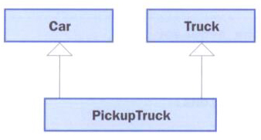
Multiple Inheritance
Java does not support multiple inheritance
The use of interfaces gives us aspects of multiple inheritance without the overhead

Slide 23
Overriding Methods
A child class can override the definition of an inherited method in favor of its own
The new method must have the same signature as the parent's method, but can have a different body
The type of the object executing the method determines which version of the method is invoked

Slide 24
//********************************************************************
// Messages.java Java Foundations
//
// Demonstrates the use of an overridden method.
//********************************************************************
public class Messages
{
//-----------------------------------------------------------------
// Creates two objects and invokes the message method in each.
//-----------------------------------------------------------------
public static void main(String[] args)
{
Thought parked = new Thought();
Advice dates = new Advice();
parked.message();
dates.message(); // overridden
}
}

Slide 25
//********************************************************************
// Thought.java Java Foundations
//
// Represents a stray thought. Used as the parent of a derived
// class to demonstrate the use of an overridden method.
//********************************************************************
public class Thought
{
//-----------------------------------------------------------------
// Prints a message.
//-----------------------------------------------------------------
public void message()
{
System.out.println("I feel like I'm diagonally parked in a " +
"parallel universe.");
System.out.println();
}
}

Slide 26
//********************************************************************
// Advice.java Java Foundations
//
// Represents some thoughtful advice. Used to demonstrate the use
// of an overridden method.
//********************************************************************
public class Advice extends Thought
{
//-----------------------------------------------------------------
// Prints a message. This method overrides the parent's version.
//-----------------------------------------------------------------
public void message()
{
System.out.println("Warning: Dates in calendar are closer " +
"than they appear.");
System.out.println();
super.message(); // explicitly invokes the parent's version
}
}

Slide 27
Overriding
A method in the parent class can be invoked explicitly using the super reference
If a method is declared with the final modifier, it cannot be overridden
The concept of overriding can be applied to data and is called shadowing variables
Shadowing variables should be avoided because it tends to cause unnecessarily confusing code

Slide 28
Overloading vs. Overriding
Overloading deals with multiple methods with the same name in the same class, but with different signatures
Overriding deals with two methods, one in a parent class and one in a child class, that have the same signature
Overloading lets you define a similar operation in different ways for different parameters
Overriding lets you define a similar operation in different ways for different object types

Slide 29
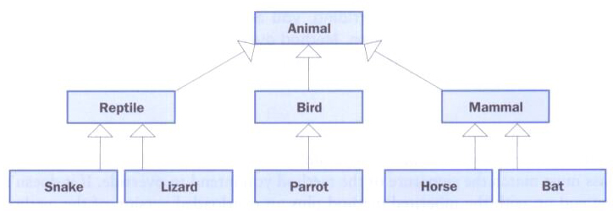
Class Hierarchies
A child class of one parent can be the parent of another child, forming a class hierarchy

Slide 30
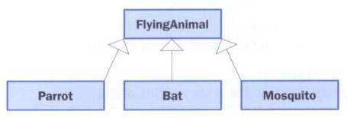
Class Hierarchies
Common features should be put as high in the hierarchy as is reasonable
A child class inherits from all its ancestor classes
There is no single class hierarchy that is appropriate for all situations

Slide 31
The Object Class
A class called Object is defined in the java.lang package of the Java standard class library
All classes are derived from the Object class
If a class is not explicitly defined to be the child of an existing class, it is assumed to be the child of the Object class
Therefore, the Object class is the ultimate root of all class hierarchies

Slide 32
The Object Class
The Object class contains a few useful methods, which are inherited by all classes
For example, the toString method is defined in the Object class
Every time we define the toString method, we are actually overriding an inherited definition
The toString method in the Object class is defined to return a string that contains the name of the object’s class along with some other information

Slide 33
The Object Class
The equals method of the Object class returns true if two references are aliases
We can override equals in any class to define equality in some more appropriate way
As we've seen, the String class defines the equals method to return true if two String objects contain the same characters
The designers of the String class have overridden the equals method inherited from Object in favor of a more useful version

Slide 34
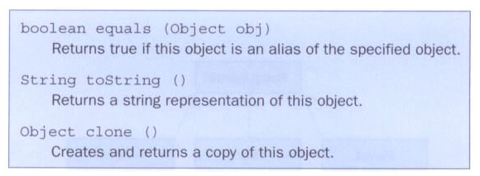
The Object Class
Some methods of the Object class:

Slide 35
Abstract Classes
An abstract class is a placeholder in a class hierarchy that represents a generic concept
An abstract class cannot be instantiated
We use the modifier abstract on the class header to declare a class as abstract:
public abstract class Product
{
// contents
}

Slide 36
Abstract Classes
An abstract class often contains abstract methods with no definitions (like an interface)
Unlike an interface, the abstract modifier must be applied to each abstract method
Also, an abstract class typically contains non-abstract methods with full definitions
A class declared as abstract does not have to contain abstract methods – simply declaring it as abstract makes it so

Slide 37
Abstract Classes
The child of an abstract class must override the abstract methods of the parent, or it too will be considered abstract
An abstract method cannot be defined as final or static
The use of abstract classes is an important element of software design – it allows us to establish common elements in a hierarchy that are too generic to instantiate

Slide 38
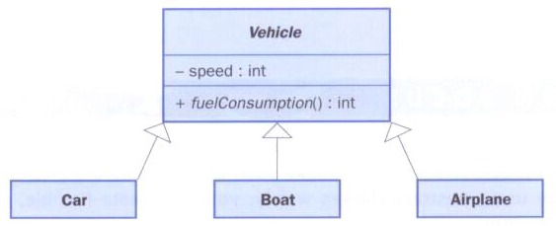
Abstract Classes
A vehicle class hierarchy:
Common features are held in the abstract Vehicle class and defined as appropriate in each child

Slide 39
Visibility Revisited
It's important to understand one subtle issue related to inheritance and visibility
As we've mentioned, private members cannot be referenced by name in the child class
However, private members inherited by child classes exist and can be referenced indirectly

Slide 40
Visibility Revisited
Because the parent can refer to the private member, the child can reference it indirectly using its parent's methods
The super reference can be used to refer to the parent class, even if no object of the parent exists

Slide 41
//********************************************************************
// FoodAnalyzer.java Java Foundations
//
// Demonstrates indirect access to inherited private members.
//********************************************************************
public class FoodAnalyzer
{
//-----------------------------------------------------------------
// Instantiates a Pizza object and prints its calories per
// serving.
//-----------------------------------------------------------------
public static void main(String[] args)
{
Pizza special = new Pizza(275);
System.out.println("Calories per serving: " +
special.caloriesPerServing());
}
}

Slide 42
//********************************************************************
// FoodItem.java Java Foundations
//
// Represents an item of food. Used as the parent of a derived class
// to demonstrate indirect referencing.
//********************************************************************
public class FoodItem
{
final private int CALORIES_PER_GRAM = 9;
private int fatGrams;
protected int servings;
//-----------------------------------------------------------------
// Sets up this food item with the specified number of fat grams
// and number of servings.
//-----------------------------------------------------------------
public FoodItem(int numFatGrams, int numServings)
{
fatGrams = numFatGrams;
servings = numServings;
}

Slide 43
//-----------------------------------------------------------------
// Computes and returns the number of calories in this food item
// due to fat.
//-----------------------------------------------------------------
private int calories()
{
return fatGrams * CALORIES_PER_GRAM;
}
//-----------------------------------------------------------------
// Computes and returns the number of fat calories per serving.
//-----------------------------------------------------------------
public int caloriesPerServing()
{
return (calories() / servings);
}
}

Slide 44
//********************************************************************
// Pizza.java Java Foundations
//
// Represents a pizza, which is a food item. Used to demonstrate
// indirect referencing through inheritance.
//********************************************************************
public class Pizza extends FoodItem
{
//-----------------------------------------------------------------
// Sets up a pizza with the specified amount of fat (assumes
// eight servings).
//-----------------------------------------------------------------
public Pizza(int fatGrams)
{
super (fatGrams, 8);
}
}

Slide 45
Designing for Inheritance
Taking the time to create a good software design reaps long-term benefits
Inheritance issues are an important part of an object-oriented design
Properly designed inheritance relationships can contribute greatly to the elegance, maintainability, and reuse of the software
Let's summarize some of the issues regarding inheritance that relate to a good software design

Slide 46
Inheritance Design Issues
Every derivation should be an is-a relationship
Design classes to be reusable and flexible
Find common characteristics of classes and push them as high in the class hierarchy as appropriate
Override methods as appropriate to tailor or change the functionality of a child
Add new variables to children, but don't redefine (shadow) inherited variables

Slide 47
Inheritance Design Issues
Allow each class to manage its own data; use the super reference to invoke the parent's constructor to set up its data
Even if there are no current uses for them, override general methods such as toString and equals with appropriate definitions
Use abstract classes to represent general concepts that lower classes have in common
Use visibility modifiers carefully to provide needed access without violating encapsulation

Slide 48
Restricting Inheritance
The final modifier can be used to curtail inheritance
If the final modifier is applied to a method, then that method cannot be overridden in any descendent classes
If the final modifier is applied to an entire class, then that class cannot be used to derive any children at all
Thus, an abstract class cannot be declared as final
A final method or class establishes that it should be used as is

